Slide 1
www.studymafia.net
Seminar
On
Edge Computing
Submitted To: Submitted By:
www.studymafia.net www.studymafia.net

Slide 2
Table Contents
Definition
Introduction
Facts About Edge Computing
Examples of Edge Computing
Cases of Edge Computing
Benefits of Edge Computing
Drawbacks of Edge Computing
Conclusion
2
Notes:
SAY: Before we wrap up the course, let’s review what we have learned today.
During this course, we have
<READ the bullets from the slide.>
GO to next slide.

Slide 3
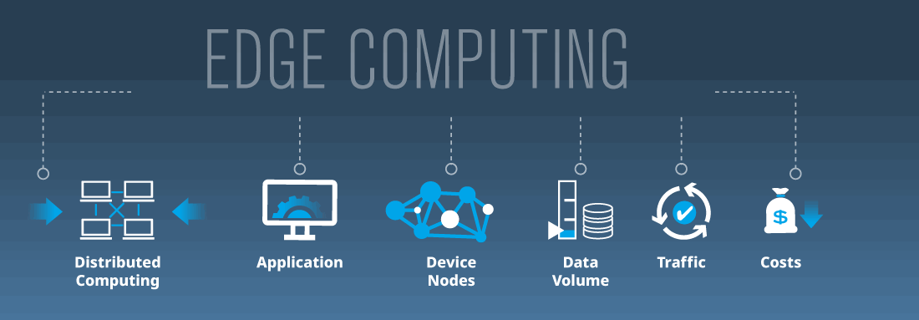
Definition
Edge computing is a distributed computing paradigm that brings computation and data storage closer to the sources of data.
3
Notes:
SAY: Before we wrap up the course, let’s review what we have learned today.
During this course, we have
<READ the bullets from the slide.>
GO to next slide.

Slide 4
Introduction
The origins of edge computing lie in content distributed networks that were created in the late 1990s to serve web and video content from edge servers that were deployed close to users.
In the early 2000s, these networks evolved to host applications and application components on edge servers, resulting in the first commercial edge computing services that hosted applications such as dealer locators, shopping carts, real-time data aggregators, and ad insertion engines.
4
Notes:
SAY: Before we wrap up the course, let’s review what we have learned today.
During this course, we have
<READ the bullets from the slide.>
GO to next slide.

Slide 5
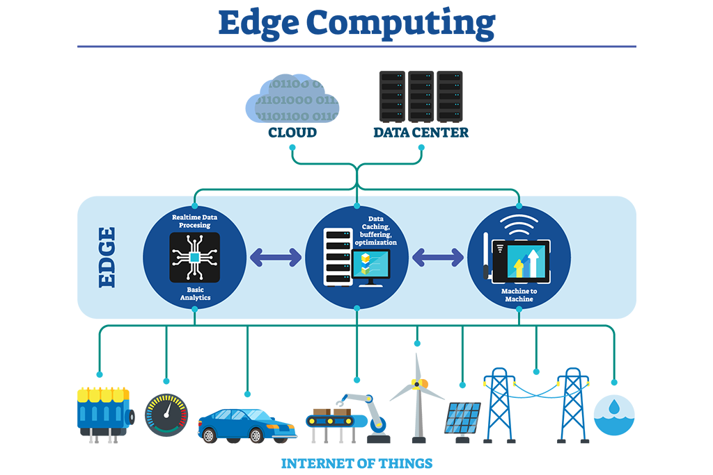
5
Notes:
SAY:
The purpose of epidemiology in public health practice is to
discover the agent, host, and environmental factors that affect health;
determine the relative importance of causes of illness, disability, and death;
identify those segments of the population that have the greatest risk from specific causes of ill health; and
evaluate the effectiveness of health programs and services in improving population health.
GO to next slide.

Slide 6
Facts About Edge Computing
The first computers were large, bulky machines that could only be accessed directly or via terminals that were basically an extension of the computer.
With the invention of personal computers, computing could take place in a much more distributed fashion.
●●●
6
Notes:
SAY:
The purpose of epidemiology in public health practice is to
discover the agent, host, and environmental factors that affect health;
determine the relative importance of causes of illness, disability, and death;
identify those segments of the population that have the greatest risk from specific causes of ill health; and
evaluate the effectiveness of health programs and services in improving population health.
GO to next slide.

Slide 7
Facts About Edge Computing
For a time, personal computing was the dominant computing model.
Applications ran and data was stored locally on a user's device, or sometimes within an on-premise data center.
Cloud computing, a more recent development, offered a number of advantages over this locally based, on-premise computing.
●●●
7
Notes:
SAY:
The purpose of epidemiology in public health practice is to
discover the agent, host, and environmental factors that affect health;
determine the relative importance of causes of illness, disability, and death;
identify those segments of the population that have the greatest risk from specific causes of ill health; and
evaluate the effectiveness of health programs and services in improving population health.
GO to next slide.

Slide 8
Facts About Edge Computing
Cloud services are centralized in a vendor-managed "cloud" (or collection of data centers) and can be accessed from any device over the Internet.
However, cloud computing can introduce latency because of the distance between users and the data centers where cloud services are hosted.
●●●
8
Notes:
SAY:
The purpose of epidemiology in public health practice is to
discover the agent, host, and environmental factors that affect health;
determine the relative importance of causes of illness, disability, and death;
identify those segments of the population that have the greatest risk from specific causes of ill health; and
evaluate the effectiveness of health programs and services in improving population health.
GO to next slide.

Slide 9
Facts About Edge Computing
Early computing: Centralized applications only running on one isolated computer
Personal computing: Decentralized applications running locally
Cloud computing: Centralized applications running in data centers
Edge computing: Centralized applications running close to users, either on the device itself or on the network edge.
9
Notes:
SAY:
The purpose of epidemiology in public health practice is to
discover the agent, host, and environmental factors that affect health;
determine the relative importance of causes of illness, disability, and death;
identify those segments of the population that have the greatest risk from specific causes of ill health; and
evaluate the effectiveness of health programs and services in improving population health.
GO to next slide.

Slide 10
Example of Edge Computing
Consider a building secured with dozens of high-definition IoT video cameras. These are "dumb" cameras that simply output a raw video signal and continuously stream that signal to a cloud server.
On the cloud server, the video output from all the cameras is put through a motion-detection application to ensure that only clips featuring activity are saved to the server’s database.
●●●
10
Notes:
SAY:
The purpose of epidemiology in public health practice is to
discover the agent, host, and environmental factors that affect health;
determine the relative importance of causes of illness, disability, and death;
identify those segments of the population that have the greatest risk from specific causes of ill health; and
evaluate the effectiveness of health programs and services in improving population health.
GO to next slide.

Slide 11
Example of Edge Computing
This means there is a constant and significant strain on the building’s Internet infrastructure, as significant bandwidth gets consumed by the high volume of video footage being transferred.
Additionally, there is very heavy load on the cloud server that has to process the video footage from all the cameras simultaneously.
●●●
11
Notes:
SAY:
The purpose of epidemiology in public health practice is to
discover the agent, host, and environmental factors that affect health;
determine the relative importance of causes of illness, disability, and death;
identify those segments of the population that have the greatest risk from specific causes of ill health; and
evaluate the effectiveness of health programs and services in improving population health.
GO to next slide.

Slide 12
Example of Edge Computing
Now imagine that the motion sensor computation is moved to the network edge. What if each camera used its own internal computer to run the motion-detecting application and then sent footage to the cloud server as needed?
This would result in a significant reduction in bandwidth use, because much of the camera footage will never have to travel to the cloud server.
●●●
12
Notes:
SAY:
The purpose of epidemiology in public health practice is to
discover the agent, host, and environmental factors that affect health;
determine the relative importance of causes of illness, disability, and death;
identify those segments of the population that have the greatest risk from specific causes of ill health; and
evaluate the effectiveness of health programs and services in improving population health.
GO to next slide.

Slide 13
Example of Edge Computing
Additionally, the cloud server would now only be responsible for storing the important footage, meaning that the server could communicate with a higher number of cameras without getting overloaded.
This is what edge computing looks like.
13
Notes:
SAY:
The purpose of epidemiology in public health practice is to
discover the agent, host, and environmental factors that affect health;
determine the relative importance of causes of illness, disability, and death;
identify those segments of the population that have the greatest risk from specific causes of ill health; and
evaluate the effectiveness of health programs and services in improving population health.
GO to next slide.

Slide 14
Cases of Edge Computing
Security system monitoring: As described above.
IoT devices: Smart devices that connect to the Internet can benefit from running code on the device itself, rather than in the cloud, for more efficient user interactions.
Self-driving cars: Autonomous vehicles need to react in real time, without waiting for instructions from a server.
●●●
14
Notes:
SAY:
The purpose of epidemiology in public health practice is to
discover the agent, host, and environmental factors that affect health;
determine the relative importance of causes of illness, disability, and death;
identify those segments of the population that have the greatest risk from specific causes of ill health; and
evaluate the effectiveness of health programs and services in improving population health.
GO to next slide.

Slide 15
Cases of Edge Computing
More efficient caching: By running code on a CDN edge network, an application can customize how content is cached to more efficiently serve content to users.
Medical monitoring devices: It is crucial for medical devices to respond in real time without waiting to hear from a cloud server.
15
Notes:
SAY:
The purpose of epidemiology in public health practice is to
discover the agent, host, and environmental factors that affect health;
determine the relative importance of causes of illness, disability, and death;
identify those segments of the population that have the greatest risk from specific causes of ill health; and
evaluate the effectiveness of health programs and services in improving population health.
GO to next slide.

Slide 16
Benefits of Edge Computing
Cost savings
As seen in the example above, edge computing helps minimize bandwidth use and server resources. Bandwidth and cloud resources are finite and cost money.
Performance
Another significant benefit of moving processes to the edge is to reduce latency. Every time a device needs to communicate with a distant server somewhere, that creates a delay.
●●●
16
Notes:
SAY:
The purpose of epidemiology in public health practice is to
discover the agent, host, and environmental factors that affect health;
determine the relative importance of causes of illness, disability, and death;
identify those segments of the population that have the greatest risk from specific causes of ill health; and
evaluate the effectiveness of health programs and services in improving population health.
GO to next slide.

Slide 17
Benefits of Edge Computing
In addition, edge computing can provide new functionality that wasn’t previously available. For example, a company can use edge computing to process and analyze their data at the edge, which makes it possible to do so in real time.
Decreased latency
Decrease in bandwidth use and associated cost
Decrease in server resources and associated cost
Added functionality
17
Notes:
SAY:
The purpose of epidemiology in public health practice is to
discover the agent, host, and environmental factors that affect health;
determine the relative importance of causes of illness, disability, and death;
identify those segments of the population that have the greatest risk from specific causes of ill health; and
evaluate the effectiveness of health programs and services in improving population health.
GO to next slide.

Slide 18
Drawback of Edge Computing
One drawback of edge computing is that it can increase attack vectors.
With the addition of more "smart" devices into the mix, such as edge servers and IoT devices that have robust built-in computers, there are new opportunities for malicious attackers to compromise these devices.
Another drawback with edge computing is that it requires more local hardware.
●●●
18
Notes:
SAY:
The purpose of epidemiology in public health practice is to
discover the agent, host, and environmental factors that affect health;
determine the relative importance of causes of illness, disability, and death;
identify those segments of the population that have the greatest risk from specific causes of ill health; and
evaluate the effectiveness of health programs and services in improving population health.
GO to next slide.

Slide 19
Drawback of Edge Computing
For example, while an IoT camera needs a built-in computer to send its raw video data to a web server, it would require a much more sophisticated computer with more processing power in order for it to run its own motion-detection algorithms. But the dropping costs of hardware are making it cheaper to build smarter devices.
19
Notes:
SAY:
The purpose of epidemiology in public health practice is to
discover the agent, host, and environmental factors that affect health;
determine the relative importance of causes of illness, disability, and death;
identify those segments of the population that have the greatest risk from specific causes of ill health; and
evaluate the effectiveness of health programs and services in improving population health.
GO to next slide.

Slide 20
Conclusion
Edge computing is an emerging computing paradigm which refers to a range of networks and devices at or near the user.
Edge is about processing data closer to where it's being generated, enabling processing at greater speeds and volumes, leading to greater action-led results in real time.
20
Notes:
SAY:
The purpose of epidemiology in public health practice is to
discover the agent, host, and environmental factors that affect health;
determine the relative importance of causes of illness, disability, and death;
identify those segments of the population that have the greatest risk from specific causes of ill health; and
evaluate the effectiveness of health programs and services in improving population health.
GO to next slide.

Slide 21
References
Studymafia.net
Seminarppt.com
Google.com
Studymafia.org
21
Notes:
SAY:
The purpose of epidemiology in public health practice is to
discover the agent, host, and environmental factors that affect health;
determine the relative importance of causes of illness, disability, and death;
identify those segments of the population that have the greatest risk from specific causes of ill health; and
evaluate the effectiveness of health programs and services in improving population health.
GO to next slide.

Slide 22
Thanks
22
Notes:
SAY:
The purpose of epidemiology in public health practice is to
discover the agent, host, and environmental factors that affect health;
determine the relative importance of causes of illness, disability, and death;
identify those segments of the population that have the greatest risk from specific causes of ill health; and
evaluate the effectiveness of health programs and services in improving population health.
GO to next slide.

