Slide 1

StudyMafia.Org
Shuttle Walk Test
Submitted To: Submitted By:
Studymafia.org Studymafia.org

Slide 2
Table Contents
  Definition
  Introduction
  About Shuttle Walk Test
  Before the Shuttle Walk Test
  After the Shuttle Walk Test
  Conclusion
2
Notes:
SAY:
Before we wrap up the course, let’s review what we have learned today.
During this course, we have
<READ the bullets from the slide.>
GO to next slide.

Slide 3
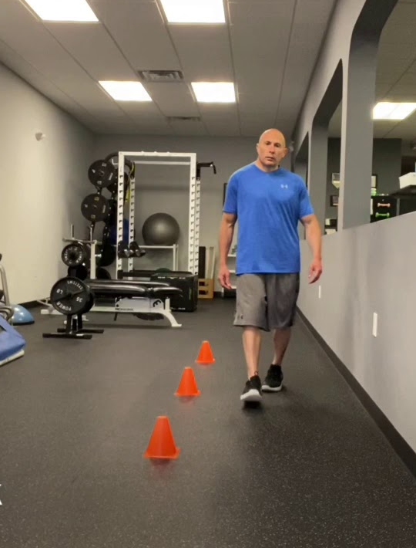
Definition
The incremental shuttle walk test (ISWT) was developed to simulate a cardiopulmonary exercise test using a field walking test.
3
Notes:
SAY:
Before we wrap up the course, let’s review what we have learned today.
During this course, we have
<READ the bullets from the slide.>
GO to next slide.

Slide 4
About Shuttle Walk Test
The patient is required to walk around two cones set 9 metres apart (so the final track is 10 metres) in time to a set of auditory beeps played on an app.
Initially, the walking speed is very slow, but each minute the required walking speed progressively increases.
●●●
4
Notes:
SAY:
The purpose of epidemiology in public health practice is to
discover the agent, host, and environmental factors that affect health;
determine the relative importance of causes of illness, disability, and death;
identify those segments of the population that have the greatest risk from specific causes of ill health; and
evaluate the effectiveness of health programs and services in improving population health.
GO to next slide.

Slide 5
About Shuttle Walk Test
The patient walks for as long as they can until they are either too breathless or can no longer keep up with the beeps, at which time the test ends.
The number of shuttles is recorded. Each shuttle represents a distance of ten metres (i.e each time the patient reaches a cone is 1 shuttle).
●●●
5
Notes:
SAY:
The purpose of epidemiology in public health practice is to
discover the agent, host, and environmental factors that affect health;
determine the relative importance of causes of illness, disability, and death;
identify those segments of the population that have the greatest risk from specific causes of ill health; and
evaluate the effectiveness of health programs and services in improving population health.
GO to next slide.

Slide 6
About Shuttle Walk Test
Standardisation of the ISWT is very important for obtaining meaningful outcomes.
The ISWT must be measured on twice to account for a learning effect. Please note that:
The best result is recorded.
If the repeat test is performed on the same day, 30 minutes rest should be allowed between tests.
●●●
6
Notes:
SAY:
The purpose of epidemiology in public health practice is to
discover the agent, host, and environmental factors that affect health;
determine the relative importance of causes of illness, disability, and death;
identify those segments of the population that have the greatest risk from specific causes of ill health; and
evaluate the effectiveness of health programs and services in improving population health.
GO to next slide.

Slide 7
About Shuttle Walk Test
Debilitated individuals may require tests to be performed on separate days, but aim for tests to be less than one week apart.
Only standardised instructions from the app should be used. In contrast to the six-minute walking test, no encouragement should be given throughout the ISWT.
●●●
7
Notes:
SAY:
The purpose of epidemiology in public health practice is to
discover the agent, host, and environmental factors that affect health;
determine the relative importance of causes of illness, disability, and death;
identify those segments of the population that have the greatest risk from specific causes of ill health; and
evaluate the effectiveness of health programs and services in improving population health.
GO to next slide.

Slide 8
About Shuttle Walk Test
A comfortable ambient temperature and humidity should be maintained for all tests.
The walking track must be the same for all tests for a patient:
Cones are placed nine metres apart.
The distance walked around the cones is 10 metres.
8
Notes:
SAY:
The purpose of epidemiology in public health practice is to
discover the agent, host, and environmental factors that affect health;
determine the relative importance of causes of illness, disability, and death;
identify those segments of the population that have the greatest risk from specific causes of ill health; and
evaluate the effectiveness of health programs and services in improving population health.
GO to next slide.

Slide 9
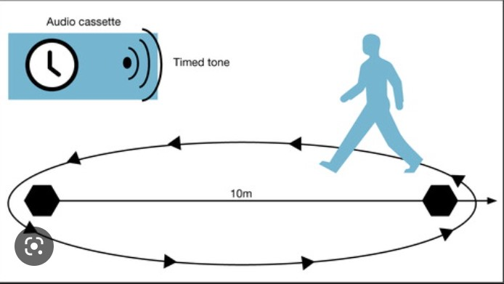

Slide 10
Before the ISWT
Instruct the patient to dress comfortably and to wear appropriate footwear.
Any prescribed inhaled bronchodilator medication should be taken within one hour of testing or when the patient arrives for testing.
The patient should rest for at least 15 minutes before beginning the ISWT.
10
Notes:
SAY:
The purpose of epidemiology in public health practice is to
discover the agent, host, and environmental factors that affect health;
determine the relative importance of causes of illness, disability, and death;
identify those segments of the population that have the greatest risk from specific causes of ill health; and
evaluate the effectiveness of health programs and services in improving population health.
GO to next slide.

Slide 11
Before the ISWT
Record:
Blood pressure.
Heart rate.
Oxygen saturation.
If a patient is on inhaled vasodilator therapy this should be administered 30 minutes prior to the exercise test.
11
Notes:
SAY:
The purpose of epidemiology in public health practice is to
discover the agent, host, and environmental factors that affect health;
determine the relative importance of causes of illness, disability, and death;
identify those segments of the population that have the greatest risk from specific causes of ill health; and
evaluate the effectiveness of health programs and services in improving population health.
GO to next slide.

Slide 12
After the ISWT
The ISWT ends if any one of the following occur:
The patient is more than 0.5 m away from the cone when the beep sounds (allow one lap to catch up).
The patient reports that they are too breathless to continue.
The patient reaches 85% of predicted maximum heart rate (maximum heart rate = 210 – 0.65 x age)
●●●
12
Notes:
SAY:
The purpose of epidemiology in public health practice is to
discover the agent, host, and environmental factors that affect health;
determine the relative importance of causes of illness, disability, and death;
identify those segments of the population that have the greatest risk from specific causes of ill health; and
evaluate the effectiveness of health programs and services in improving population health.
GO to next slide.

Slide 13
After the ISWT
The patient exhibits any of the following signs and symptoms:
Chest pain that is suspicious of / for angina.
Evolving mental confusion or lack of coordination.
Evolving light-headedness.
Intolerable dyspnoea.
Leg cramps or extreme leg muscle fatigue.
Persistent SpO2 < 85%.
●●●
13
Notes:
SAY:
The purpose of epidemiology in public health practice is to
discover the agent, host, and environmental factors that affect health;
determine the relative importance of causes of illness, disability, and death;
identify those segments of the population that have the greatest risk from specific causes of ill health; and
evaluate the effectiveness of health programs and services in improving population health.
GO to next slide.

Slide 14
After the ISWT
Seat the patient or, if the patient prefers, allow to the patient to stand.
Immediately record oxygen saturation (SpO2)%, heart rate and dyspnoea rating.
Two minutes later, record SpO2% and heart rate to assess the recovery rate.
Record the total number of shuttles.
●●●
14
Notes:
SAY:
The purpose of epidemiology in public health practice is to
discover the agent, host, and environmental factors that affect health;
determine the relative importance of causes of illness, disability, and death;
identify those segments of the population that have the greatest risk from specific causes of ill health; and
evaluate the effectiveness of health programs and services in improving population health.
GO to next slide.

Slide 15
After the ISWT
Record the reason for terminating the test. The patient can be asked: “What do you think stopped you from keeping up with the beeps?”
The patient should remain in a clinical area for at least 15 minutes following an uncomplicated test.
●●●
15
Notes:
SAY:
The purpose of epidemiology in public health practice is to
discover the agent, host, and environmental factors that affect health;
determine the relative importance of causes of illness, disability, and death;
identify those segments of the population that have the greatest risk from specific causes of ill health; and
evaluate the effectiveness of health programs and services in improving population health.
GO to next slide.

Slide 16
Conclusion
The change in the distance walked in the ISWT can be used to evaluate the effectiveness of an exercise training program and / or to track the change in exercise capacity over time.
The minimal important difference in the distance walked is an improvement between 35m to 58m.8
16
Notes:
SAY:
The purpose of epidemiology in public health practice is to
discover the agent, host, and environmental factors that affect health;
determine the relative importance of causes of illness, disability, and death;
identify those segments of the population that have the greatest risk from specific causes of ill health; and
evaluate the effectiveness of health programs and services in improving population health.
GO to next slide.

Slide 17
References
  Google.com
  Wikipedia.org
  Studymafia.org
  Slidespanda.com

Slide 18
Thanks
To
StudyMafia.org

