Slide 1
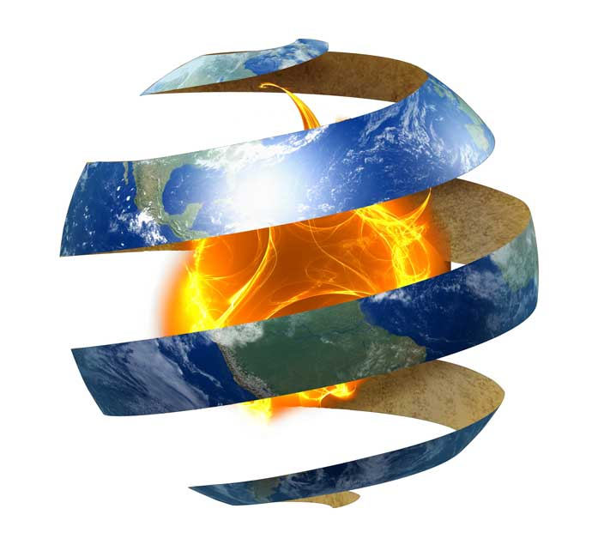
www.studymafia.net
Seminar
On
Geothermal Energy
Submitted To: Submitted By:
www.studymafia.net www.studymafia.net
Notes:
1

Slide 2
Index
Introduction
What is Geothermal Energy
History
Applications
Types
Uses of Geothermal Energy
Advantages
Disadvantages
Future of Geothermal Energy
Conclusion
References

Slide 3
Introduction
Geothermal energy is the earth’s natural heat available inside the earth.
This thermal energy contained in the rock and fluid that filled up fractures and pores in the earth’s crust can profitably be used for various purposes.
Geothermal energy is an enormous, underused heat and power resource that is clean (emits little or no greenhouse gases), reliable (average system availability of 95%), and homegrown (making us less dependent on foreign oil).

Slide 4
What is geothermal energy?
Geothermal energy is defined as heat from the Earth.
It is a clean, renewable resource that provides energy in the U.S. and around the world in a variety of applications and resources.

Slide 5
History
Paleo-American Indians used hot springs in this area
Hot Springs, Arkansas had $1 hot baths in 1830
First electricity (20kW) from geothermal produced from natural steam in Larderello, Italy in 1904 [Kruger, 1973]
New Zealand’s north island gets 6% of its electricity from geothermal energy
1920: test boring in Niland CA
1922: electricity generation in The Geysers
1950: 95°F, 220kW generating plant in Katanga
The Geysers CA expanded to 600MW in 1975

Slide 6
Applications …
1. Space/District Heating: Schemes utilizing geothermal heat provide over 80% of the central heating needs of Reykjavik city in Iceland and are employed in many towns in USA, Poland and Hungary.
2. Agriculture and Aquaculture: In temperate and colder climates, greatly improved plant and fish growth can be achieved by heating soils, greenhouses and fish ponds using geothermal heat.
3. Power Generation: With over 8000 MW of installed capacity, geothermal electric power generation is a well-proven technology that has been especially successful in countries and islands that have a high reliance on imported fossil fuels (World Bank Group, 2004).

Slide 7
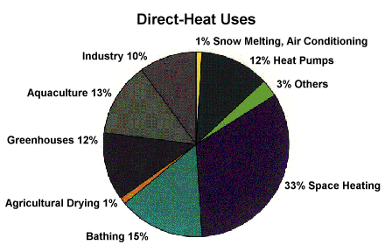
Applications

Slide 8
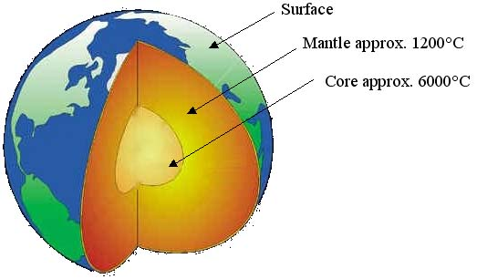
The structure of the earth
The heat contained within the earth would cover our present world energy need for 30 million years. When you look at the temperature in and on Earth you can see that 99% of the planet has a temperature over 1000°C, while only 0.1% of the earth is cooler than 100°C.

Slide 9
Costs of Geothermal Energy
Costs for geothermal electricity generation are 4.5-7 cents per kilowatt-hour. This is competitive with some fossil fuel facilities, but one must keep in mind the drastic reduction of pollution.
Delivered costs depend on ownership arrangements, financing, transmission, the quality of the resource, and the size of the project.
Geothermal plants are relatively capital-intensive, with low variable costs and no fuel costs.

Slide 10
Where Is Geothermal Energy Found?
What does geothermal energy look like? Some visible features of geothermal energy are volcanoes, hot springs, geysers, and fumaroles.
But you cannot see most geothermal energy. Usually geothermal energy is deep underground.
There may be no clues above ground to what exists below ground.

Slide 11
Geothermal Energy and the Environment
Geothermal energy is a renewable energy source that does little damage to the environment.
Geothermal steam and hot water do contain naturally occurring traces of hydrogen sulfide (a gas that smells like rotten eggs) and other gases and chemicals that can be harmful in high concentrations.

Slide 12
Uses of geothermal energy
Industrial processes
Geothermal prawn farming
Horticulture
Crop and timber drying

Slide 13
Types
Liquid-dominated plants
Liquid-dominated reservoirs (LDRs) are more common with temperatures greater than 200 °C (392 °F) and are found near young volcanoes surrounding the Pacific Ocean and in rift zones and hot spots.
Thermal energy
Lower temperature sources produce the energy equivalent of 100M BBL per year. Sources with temperatures from 30-150 C are used without conversion to electricity for as district heating, greenhouses, fisheries, mineral recovery, industrial process heating and bathing in 75 countries.

Slide 14
Types ….
Enhanced geothermal
Enhanced geothermal systems (EGS) actively inject water into wells to be heated and pumped back out.
The water is injected under high pressure to expand existing rock fissures to enable the water to freely flow in and out.

Slide 15
Advantages
It is a renewable source of energy.
By far, it is non-polluting and environment friendly.
There is no wastage or generation of by-products.
Geothermal energy can be used directly. In ancient times, people used this source of energy for heating homes, cooking, etc.

Slide 16
Disadvantages
Only few sites have the potential of Geothermal Energy.
Most of the sites, where geothermal energy is produced, are far from markets or cities, where it needs to be consumed.
Total generation potential of this source is too small.
There is always a danger of eruption of volcano.

Slide 17
Energy Source: Geothermal
Capturing and Using Geothermal
The most common current way of capturing the geothermal energy is to tap into naturally occurring hydrothermal convection systems containing pressurized hot water or steam.
Benefits
Geothermal power plants do not have to use an intermediate technology to produce steam to power the turbine generators.
The land needed for geothermal power plants is smaller per megawatt than for almost any other type of power plant.

Slide 18
Challenges
Geothermal energy can only be used in areas where the earth's crust is thin and the steam or hot water sources are close to the surface.
Sometimes the hot water that is pumped to the surface contains pollutants such as sulphur, which must be removed before using in a power plant.

Slide 19
Global Status and Potential
Geothermal energy is used widely in Iceland, the Philippines, Italy, Indonesia, Mexico, New Zealand, Japan and China. Iceland relies on geysers as its primary source of heat.
The United States is the world's largest producer of geothermal electricity with 2,800 MW in service.

Slide 20
Future Of Geothermal Energy
The future of geothermal energy depends on three factors: it’s demand, supply and it’s competitiveness among other renewable resources in terms of cost, availability, reliability etc.

Slide 21
Conclusion
Geothermal energy is limited in extent as extracting the heat usually exceeds the replenishment rate
Hot, dry rock (HDR) is widespread and offers new resources in areas where geyser activity is unknown
Direct low-temperature heat transfer for home systems is practical as long as low maintenance is designed into the system
Sources of high temperature water or steam are limited and the cost of extraction, maintenance, and operation will remain high in comparison with other sources of energy

Slide 22
Reference
www.studymafia.net
www.google.com
www.wikipedia.com

Slide 23
Thanks To Studymafia.org

