Slide 1
www.studymafia.Net
Seminar
On
GSM
Submitted To: Submitted By:
www.studymafia.net www.studymafia.net
Notes:
1

Slide 2
Index
Introduction
What is GSM
What does GSM offer?
Why GSM?
Services provided by GSM
History
Architecture
GSM Network along with added elements
GSM network areas
Advantages
Disadvantages
Conclusion
References

Slide 3
Introduction
At the beginning of the 1980s it was realized that the European countries were using many different, incompatible mobile phone systems.
At the same time, the needs for telecommunication services were remarkably increased.
Due to this, CEPT (Conférence European Posts Telecommunications) founded a group to specify a common mobile system for Western Europe. This group was named “Groupe Spéciale Mobile” and the system name GSM arose.

Slide 4
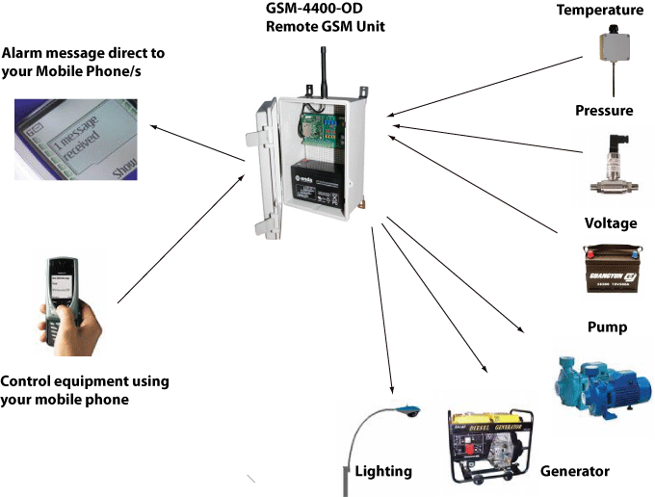
What is GSM?
GSM (Global System for Mobile communications) is an open, digital cellular technology used for transmitting mobile voice and data services.

Slide 5
What does GSM offer?
GSM supports voice calls and data transfer speeds of up to 9.6 kbps, together with the transmission of SMS (Short Message Service).
GSM operates in the 900MHz and 1.8GHz bands in Europe and the 1.9GHz and 850MHz bands in the US. GSM services are also transmitted via 850MHz spectrum in Australia, Canada and many Latin American countries.

Slide 6
Why GSM?
The GSM study group aimed to provide the followings through the GSM:
Improved spectrum efficiency.
International roaming.
Low-cost mobile sets and base stations (BSs).
High-quality speech.
Compatibility with Integrated Services Digital Network (ISDN) and other telephone company services.
Support for new services.

Slide 7
Services provided by GSM
From the beginning, the planners of GSM wanted ISDN compatibility in terms of the services offered and the control signalling used.
However, radio transmission limitations, in terms of bandwidth and cost, do not allow the standard ISDN B-channel bit rate of 64 kbps to be practically achieved.
Using the ITU-T definitions, telecommunication services can be divided into bearer services, teleservices, and supplementary services.
The most basic teleservice supported by GSM is telephony.

Slide 8
History
Driving Factors:
Incompatibility of the European analog cellular systems
Reaching of capacity limits
Costs of the equipment
1982, Conference of European Post and Telecommunications formed Group Speciale Mobile (GSM)

Slide 9
History …
1987, 15 operators from 13 countries signed Memorandum of Understanding (MoU)
1991, Finland’s operator Radiolinia launched first GSM network in July 1991
1992, Massive deployment of GSM started
By 2000 GSM became the most popular 2G technology worldwide
GSM standard still evolving and enriched with new features and services

Slide 10
Architecture
A GSM network consists of several functional entities, whose functions and interfaces are defined. The GSM network can be divided into following broad parts.
The Mobile Station (MS)
The Base Station Subsystem (BSS)
The Network Switching Subsystem (NSS)
The Operation Support Subsystem (OSS)

Slide 11
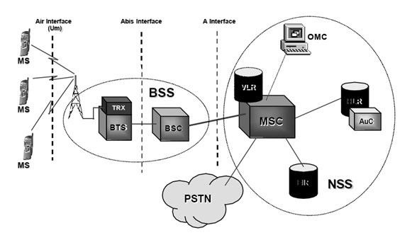
Architecture…

Slide 12
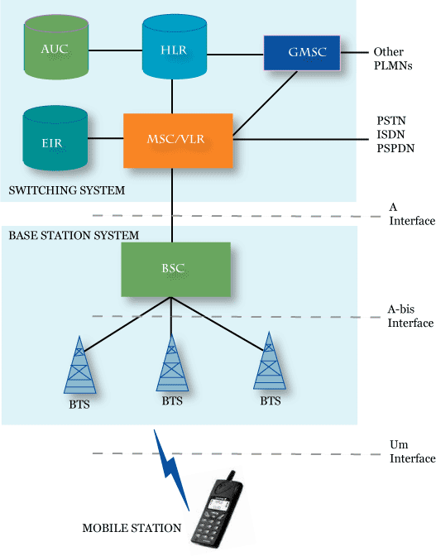
GSM Netwrok along with added elements:

Slide 13
GSM network areas
Cell: Cell is the basic service area: one BTS covers one cell. Each cell is given a Cell Global Identity (CGI), a number that uniquely identifies the cell.
Location Area: A group of cells form a Location Area. This is the area that is paged when a subscriber gets an incoming call.
MSC/VLR Service Area: The area covered by one MSC is called the MSC/VLR service area.
PLMN: The area covered by one network operator is called PLMN. A PLMN can contain one or more MSCs.

Slide 14
Advantages
GSM is more suitable network with robust pitfall.
Low signal inside the building and house.
The subscriber globally creates much better in network effect for GSM handset maker’s carries and end users.
It can be use repeaters.
A customer has been better voice quality and low cost amount in alternatives to making cells like (sms) etc.
It is easy to implement.

Slide 15
Disadvantages
Many of the technology are patented and should be license from qualcomm.
When customers using particular sites going up and the range of the sites goes down.
Manufactures are not release IS-95 devices due to the lack of the big market and it come in late in market.

Slide 16
Conclusion
In the analog communication systems the voice quality was poor and in the GSM networks we find good voice quality and the frequency range is also increased. The transformation has been going and the third generation networks are being used and it has higher frequency ranges and data rates.

Slide 17
References
www.studymafia.net
www.google.com
www.wikipedia.com

Slide 18
THANKS To StudyMafia.net

