Slide 1
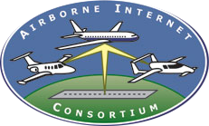
www.studymafia.NET
Seminar
On
Airborne Internet
Submitted To Submitted By:
www.studymafia.Net www.studymafia.Net

Slide 2
Content
Abstract
Introduction
History
What is Airborne Internet
How Airborne Internet Works
Requirements

Slide 3
Content
Key Features
Implementation System
Application
Advantages
Future Activity
Conclusion
Reference

Slide 4
Abstract

Slide 5
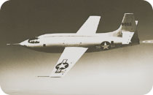
Introduction
The word on just about every Internet user's lips these days is "broadband." We have so much more data to send and download today, including audio files, video files and photos, that it's clogging our wimpy modems.
Many Internet users are switching to cable modems and digital subscriber lines (DSLs) to increase their bandwidth.
There's also a new type of service being developed that will take broadband into the air. In this paper, we'll learn about the future of the Airborne Internet.

Slide 6
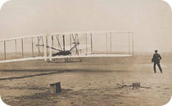
History
Breaking the information barrier
In 1903, the Wright brothers made aviation history when they broke the chains of gravity holding man to the earth. In 1947, Chuck Yeager ushered in a new age of flight when he broke the sound barrier.
In 1999, Ralph Yost from the FAA Technical Center broke the information barrier when he conceived of a system in which aircraft would be connected with a scalable, general purpose, and multi-application aviation data channel and treated as nodes in a network.
The Airborne Internet Consortium (AIC) is helping to advocate this concept, which is known as the Airborne Internet.

Slide 7
What is Airborne Internet
Also known simply as AI, the airborne Internet is a communication network that is designed to include nodes or points of contact or interaction on different types of aircraft.
First conceived in 1999, the idea of an Internet communications and delivery system that is air-based for use by passengers and crew on airplanes has undergone some revisions over the years, especially as technology continued to advance during the first decade of the 21st century.

Slide 8
Works of Airborne Internet
The concept seems pretty simple, have a plane flying over head in a pattern carrying long range 4g transmitters, transmitting internet across the city.
Looking into the triginomotry in this, it could potentially cover an area of up to 30-40 miles.
I ran some numbers, and to have 2 Beechcraft Barons flying so that one was always in the air, it would cost $5,000 a day roughly.
If you had 5,000 customers, paying $30 a month for high-speed internet from this service, then doesn't this business venture sound like it has potential?

Slide 9
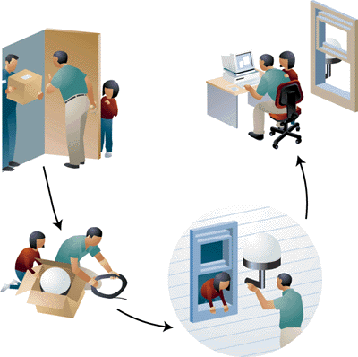
How airborne internet works

Slide 10
REQUIREMENTS
The airborne Internet won't be completely wireless. There will be ground-based components to any type of airborne Internet network.
The consumers will have to install an antenna on their home or business in order to receive signals from the network hub overhead.
The networks will also work with established Internet Service Providers (ISPs), who will provide their high-capacity terminals for use by the network.

Slide 11
Key Features
The key features the HALO™ Network are summarized below
Seamless ubiquitous multimedia services
Adaptation to end user environments
Enhanced user connectivity globally
Rapidly deployable to sites of opportunity
Secure and reliable information transactions
Bandwidth on demand provides efficient use of available spectrum.

Slide 12
IMPLEMENTATION SYSTEMS
Angel Technologies
Angel Technologies Corporation, with headquarters in St. Louis, Mo., is a privately-held wireless communications company using proprietary High Altitude Long Operation (HALO™) aircraft to deliver services worldwide.
Augmenting terrestrial towers and orbiting satellites, Angel's HALO aircraft will fly fixed patterns in the stratosphere above major cities to deliver metropolitan wireless services at lower cost, with increased flexibility and improved quality of service.

Slide 13
IMPLEMENTATION SYSTEMS
Sky Station International
Sky Station International has pioneered technology that utilizes a solar powered lighter-than-air platform held geostationary in the stratosphere to provide high capacity wireless telecommunications services to large metropolitan regions.
Worldwide regulatory approval for the use of stratospheric platforms was granted by the ITU inNovember 1997 and by the U.S. Federal Communications Commission (FCC) earlier that year.

Slide 14
IMPLEMENTATION SYSTEMS
Aero Vironment With NASA
AeroVironment Inc is a technology company in Monrovia, California, and Simi Valley, California, that is primarily involved in energy systems, electric vehicle systems, and unmanned aerial vehicles (UAVs).
Paul B. MacCready, Jr., a famous designer of human powered aircraft, founded the company in 1971. The company is probably most well-known for developing a series of lightweight human-powered and then solarpowered vehicles.

Slide 15
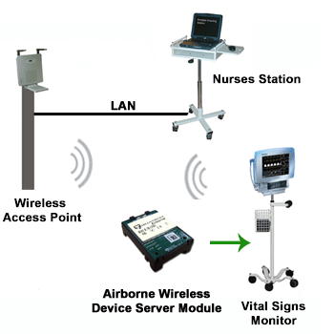
Applications
The Airborne modules have been designed and tested to provide wireless LAN (WLAN) and Internet connectivity across the harshest of machine to machine environments including:
transportation
medical
warehouse and logistics
point-of-sale (POS)
industrial automation
military
scientific research
Equipment with an embedded Airborne module can be monitored and controlled by a handheld device, by a PC in a central location or over the Internet.

Slide 16
Application……..
Airborne Internet (A.I.) is an approach to provide a general purpose, multi-application data channel to aviation. In doing so, A.I. has the potential to provide significant cost savings for aircraft operators and the FAA, as it allows the consolidation of many functions into a common data channel.
A primary application for A.I. is to track aircraft for the air traffic control system. Many other applications can utilize the same A.I. data channel. The applications available are only limited by the bandwidth available.

Slide 17
Application……..
A.I. began as a supporting technology for NASA’s Small Aircraft Transportation System (SATS).
But there is no reason that A.I. should be limited to SATS-class aircraft. All of aviation, and even transportation, has the potential to benefit from A.I.
The principle behind the A.I. is to establish a robust, reliable, and available digital data channel to aircraft.
Establishing the general purpose, multi-application digital data channel connection to the aircraft is analogous to the connection of a desktop computer to its local area network, or even the wide area network we call the Internet.

Slide 18
ADVANTAGES
Unique feature of these solar-electric air-craft that make then appealing platforms for telecommunications applications include:
Long flight durations up to 6 months or more.
Minimal maintenance cost due to few moving parts.
High levels of redundancy (e. g. aircraft could lose multiple motors and still maintain station and land safely - most failure modes do not require immediate response by ground operator)
Highly autonomous controls which enable one ground operator to control multiple aircraft.
Use of solar energy to minimize fuel costs.

Slide 19
Future Activities

Slide 20
CONCLUSION
Thus this airborne internet technology has a wide range of utilities in the field of aviation services like aircraft monitoring and air traffic management, weather information etc.
It is also provides an opportunity for the passengers to access the internet at very high altitudes that is, in the aeroplanes and other conventional services.

Slide 21
References:
www.airborneinternet.org
www.airborneinternet.com
airborneinternet.pbwiki.com
spacecom.grc.nasa.gov/icnsconf/docs/2006/02_Session_A1
acb100.tc.faa.gov/Briefings/Sept28,2005Keegan
web.uwaterloo.ca/uwsearch.php?hl=en&lr=&ie=UTF-
8&q=related:www.aerosat.com
www.studymafia.net

Slide 22
Thanks to studymafia.net

