Slide 1
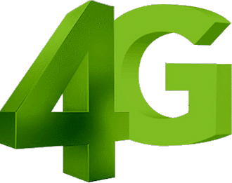
www.studymafia.net
Seminar
On
4G Technology
Submitted To: Submitted By:
www.studymafia.net www.studymafia.net
Notes:
1

Slide 2
CONTENTS
INTRODUCTION
OBJECTIVES AND APPROACHES
DEVLOPMENT FROM 1G TO 4G
PRINCIPAL TECHNOLOGIES
DEVELOPMENTS
APPLICATIONS AND ADVANTAGES
REFERENCES

Slide 3
INTRODUCTION
4G is the short term for fourth-generation wireless. It is still a research lab standard , the stage of broadband mobile communications that will supersede the third generation (3G). It is expected that end-to-end IP and high-quality streaming video will be among 4G's distinguishing features.
A 4G system will be able to provide a comprehensive IP solution where voice , data and streamed multimedia can be given to the users on “ Anytime Anywhere ” basis and higher data rates than the previous generations.
It will be a fully IP based integrated system capable of providing between 100 Mbps to 1 Gbps in both indoor and outdoor with premium quality and high security.
It is going to be launched in the year 2010.

Slide 4
OBJECTIVE
4G is being developed to accommodate the Quality of Service (QOS) and rate requirements set by forth coming applications like
1. MMS (Multimedia Messaging Service).
2. Wireless Broadband Service.
3. Video Chat.
4. Mobile TV.
5. Digital Video Broadcasting.
6. High Network Capacity.
7. Data Rate of 100 Mbps for mobile and 1 Gbps while stationary .
8. Smooth handoff across heterogeneous network..
9. Seamless Connectivity and Global Roaming across multiple networks.

Slide 5
Time-line from 1G to 4G and beyond:
The first generation, 1G wireless mobile communication systems, was introduced in the early 1980s. 1G wireless was analog and supported the first generation of analog cell phones with the speeds up to 2.4kbps.
The second generation, 2G system, fielded in the late 1980s.It was planned mainly for voice transmission with digital signal and the speeds up to 64kbps.
The third generation, 3G wireless system, also called UMTS (Universal Mobile Telecommunications Standard). , was developed in the late 1990s .3G is not only provided the transmission speeds from 125kbps to 2Mbps, but also included many services, such as global roaming, superior voice and video quality.
The fourth generation, 4G is a conceptual framework just raised in 2002. The speeds of 4G can theoretically be promised up to 1Gbps. The beyond will be 5G with incredible transmission speed with no limitation for access and zone size.

Slide 6
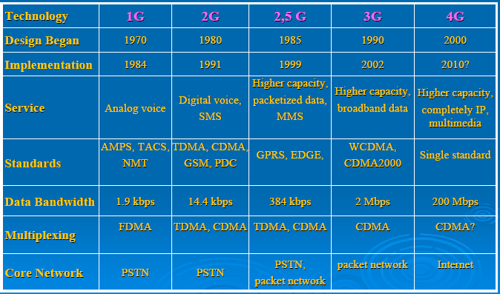
GENERATIONS TIMELINE :

Slide 8
Telecom Companies Developing 4G
NTT DoCoMo (JAPAN)
DIGIWEB (IRELAND)
SPRINT (CHICAGO)
VERIZON WIRELESS
VODAFONE GROUP
AMERICAN WIRELESS PROVIDER CLEARWIRE ETC..

Slide 9
APPLICATIONS
The applications of 4G are called “KILLER APPLICATIONs” as it is going to bring to revolution in the internet world.
-- High Speed Data Rate due to which a movie
can be downloaded in 2 to 3 minutes.
-- More Security.
-- Video Conferencing.
-- Higher Bandwidth.
-- Global Roaming.

Slide 10
ADVANTAGES
High Speed:– Data Rate of 100 Mbps for mobile and 1 Gbps while stationary.
Global Standard:-4G will be a global standard that provides global mobility and service portability so that service provider will no longer be limited by single-system.
Low Cost:– Access technologies, services and applications can unlimitedly be run through wireless backbone over wire-line backbone using IP address.
Notes:
APPLICATIONS
10

Slide 11
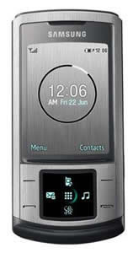
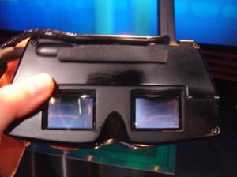
4G Phones:
T3’s 3D GOGGLE PHONE
NOKIA’s WRISTBAND
PHONE
SAMSUNG :

Slide 12
FUTURE OF 4G:5G (completed WWWW: World Wide Wireless Web):
The idea of WWWW, World Wide Wireless Web, is started from 4G technologies. The following evolution will based on 4G and completed its idea to form a Real wireless world.
Thus, 5G should make an important difference and add more services and benefit to the world over 4G. 5G should be a more intelligent technology that interconnects the entire world without limits.

Slide 13
CONCLUSION
As the history of mobile communications shows, attempts have been made to reduce a number of technologies to a single global standard.
4G seems to be a very promising generation of wireless communication that will change the people’s life in the wireless world.
4G is expected to be launched by 2010 and the world is looking forward for the most intelligent technology that would connect the entire globe.

Slide 14
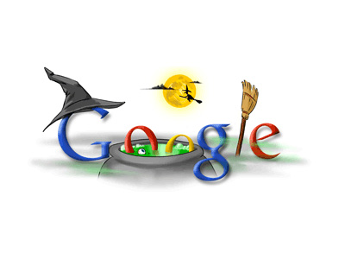
REFERENCES
www.3g4g.co.uk/4g
4G Prototype Testing by
W. Knight
www.studymafia.net

Slide 15
Th@nk U....

